Slide 1
A LONG-TERM DOCUMENT MANAGEMENT STRATEGY
Form-Forge
From Paper to Platform
How our forms, approvals, compliance records and vendor documentation move onto one
secure, self-hosted system — built to keep every record safe for the long run.
Leadership Briefing · Prepared August 2026

Slide 2





WHAT WE'LL COVER
One Platform, Five Things To Know
01
The Challenge
Why paper and scattered files no longer work for us
02
The Platform
How forms, approvals and records move automatically
03
Document Management
Where every record lives — safely, for the long term
04
Security & Access
Who can see what, and why that's protected
05
The Roadmap & The Ask
Where this goes next, and what we need from leadership
FormForge · Document & Operations Platform
2

Slide 3



THE CHALLENGE TODAY
Our Records Live in Too Many Places
Permits, inspection logs and vendor paperwork move through email threads, shared drives and
printed forms. Nothing connects — so nothing is easy to prove, trust, or find later.
24 hours
Email chains
Spreadsheets
No audit trail
Average time to turn around a single work permit today
Approvals tracked as reply-all threads with no single record
Compliance and inspection schedules kept outside the system of record
Hard to prove who approved what, from where, and when
FormForge · Document & Operations Platform
3

Slide 4





OUR ANSWER
One platform for the whole life of a document —
not just the moment it's filled in.
Every safety permit, inspection form and vendor document is captured digitally, routed for approval
automatically, tracked for compliance, and kept safe in one long-term, auditable record — for as
long as we need it.
Capture
Route
Approve
Retain
Audit
FormForge · Document & Operations Platform
4
4

Slide 5
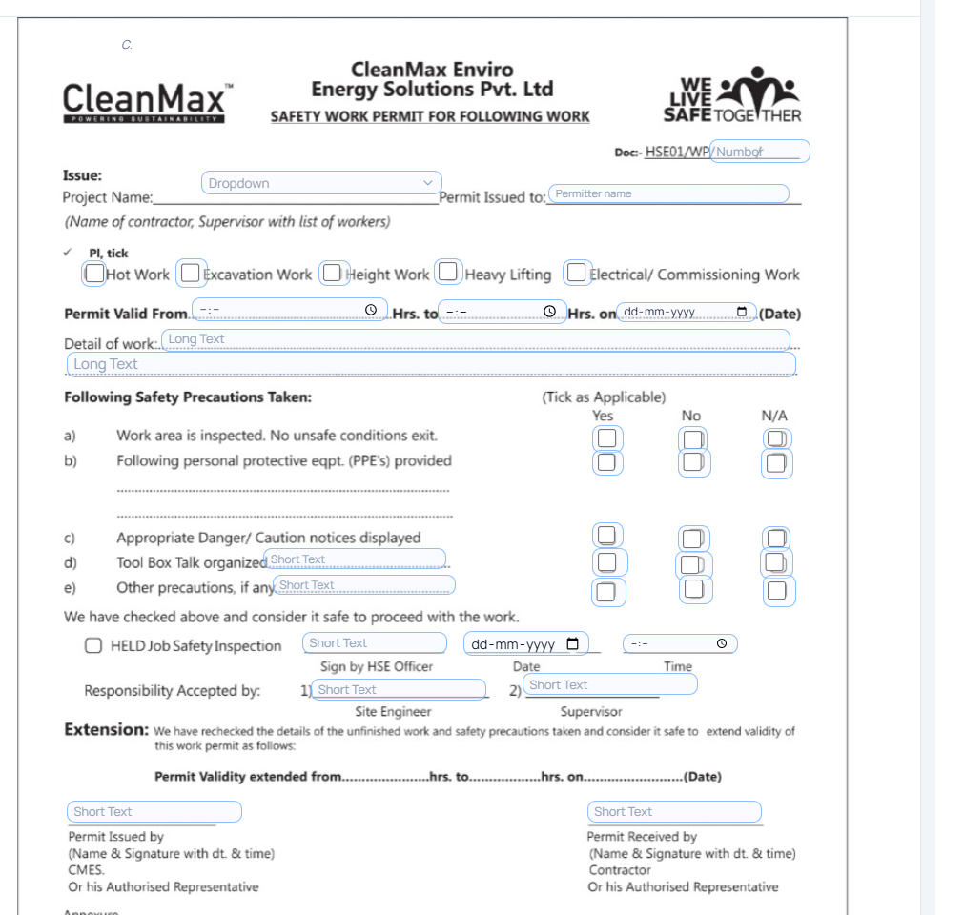
STEP 1 OF 5 · CAPTURE
Every Paper Form, Digitised
Existing permits and checklists — like our Safety Work Permit — are rebuilt as fillable digital forms, so field teams keep the layout they already know.
Signatures, photos, checkboxes, dropdowns and site look-ups are all supported — no re-training required.
Works from a phone or tablet in the field; no app install, no paper to lose.
Every version is saved automatically as it's filled in, so nothing is lost to a dropped connection.
Our own CleanMax Safety Work Permit, rebuilt as a digital form
FormForge · Document & Operations Platform
5

Slide 6
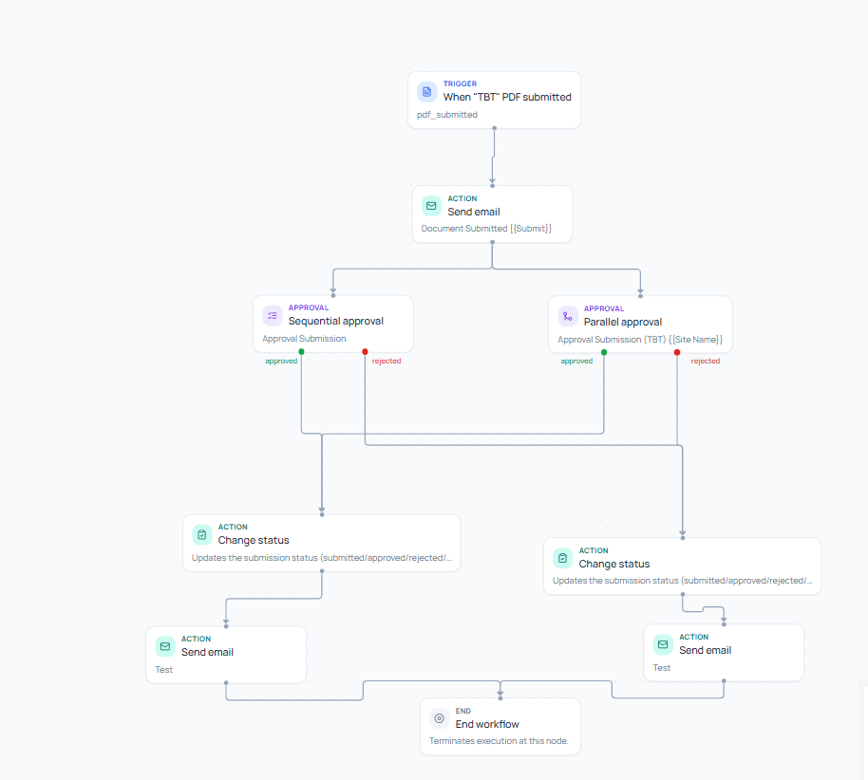
STEP 2 OF 5 · ROUTE & APPROVE
Approvals Happen on Their Own
• 85% Turnaround Speedup: Reduces work permit approvals from 24-48 hours down to under 1 hour.
The moment a form is submitted, it's automatically sent to the right approver — no one has to remember to forward it.
Multi-step sign-off is supported: one approver, or several in sequence or in parallel.
Approvers get an email and can approve or reject with one click, from anywhere.
Status updates itself in real time, so everyone always knows where a submission stands.
24 hrs → under 1 hr
Target reduction in permit turnaround time once approvals are automated
A real approval flow — set up once, runs automatically after that
FormForge · Document & Operations Platform
6

Slide 7
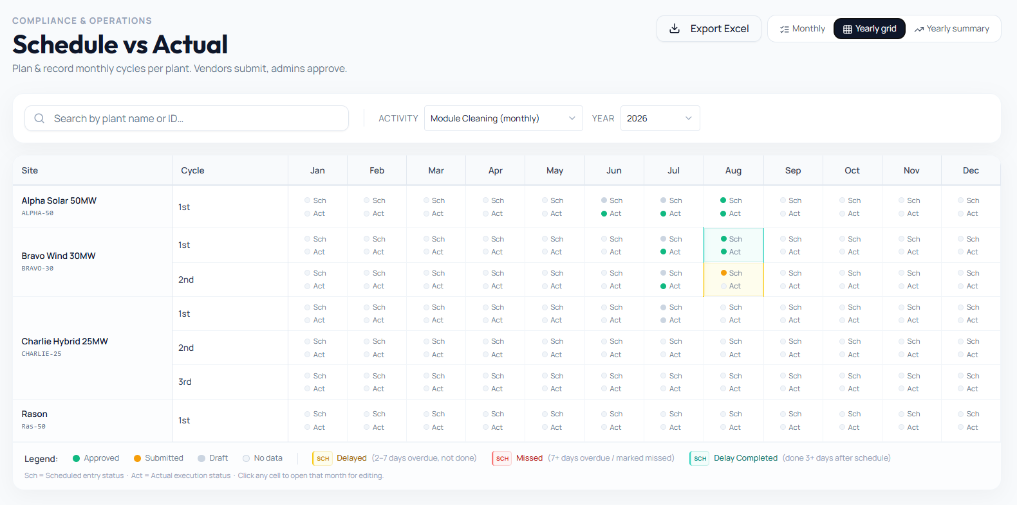
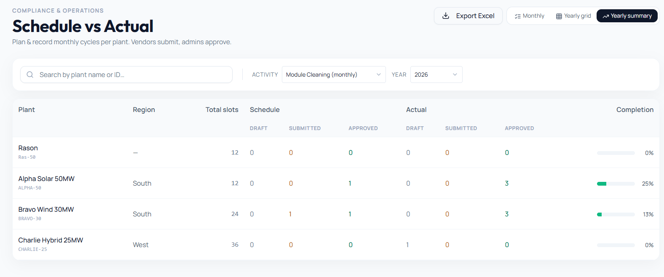
STEP 3 OF 5 · TRACK COMPLIANCE
Nothing Falls Through the Cracks
Recurring work — module cleaning, equipment testing, maintenance cycles — is scheduled automatically per site.
A simple colour system shows what's on time, delayed, or missed — no one has to chase a spreadsheet.
Vendors submit their completed work; admins review and approve it in the same place.
A yearly view gives leadership a single glance at compliance across every site.
Every site, every month, every cycle — at a glance
FormForge · Document & Operations Platform
7

Slide 8
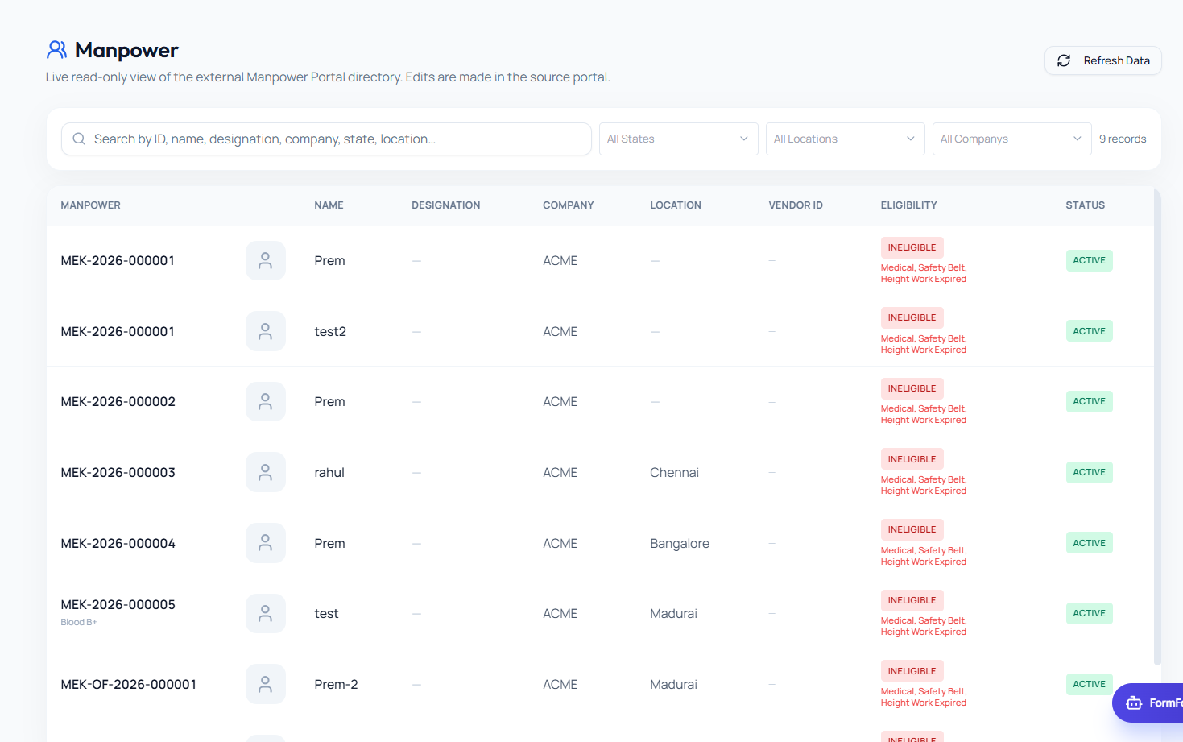
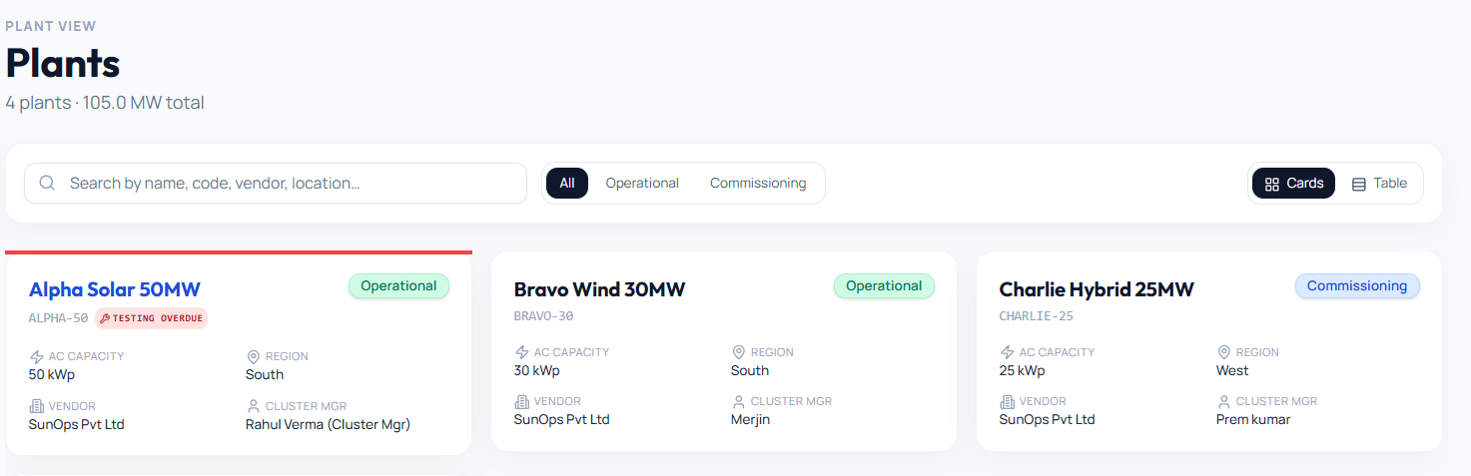
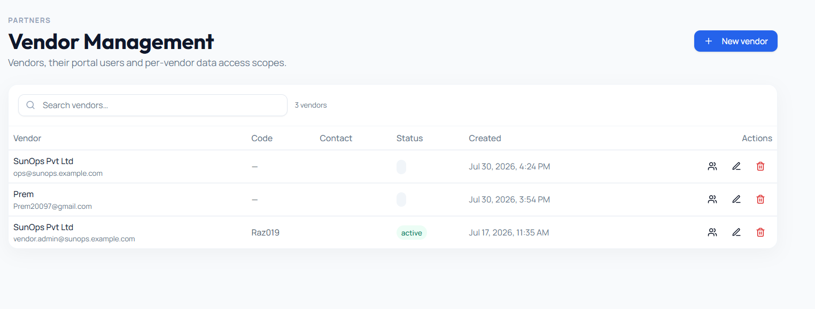
STEP 3 OF 5 · ONE SOURCE OF TRUTH
Plants, Vendors and People — Always Current
Sites
Vendors
Workforce
Every plant's capacity, location, vendor and approver, kept up to date with a full edit history.
Each partner company, its portal users, and exactly what data they're allowed to see.
A live view of who's certified and eligible to work, synced from our workforce system.
FormForge · Document & Operations Platform
8

Slide 9
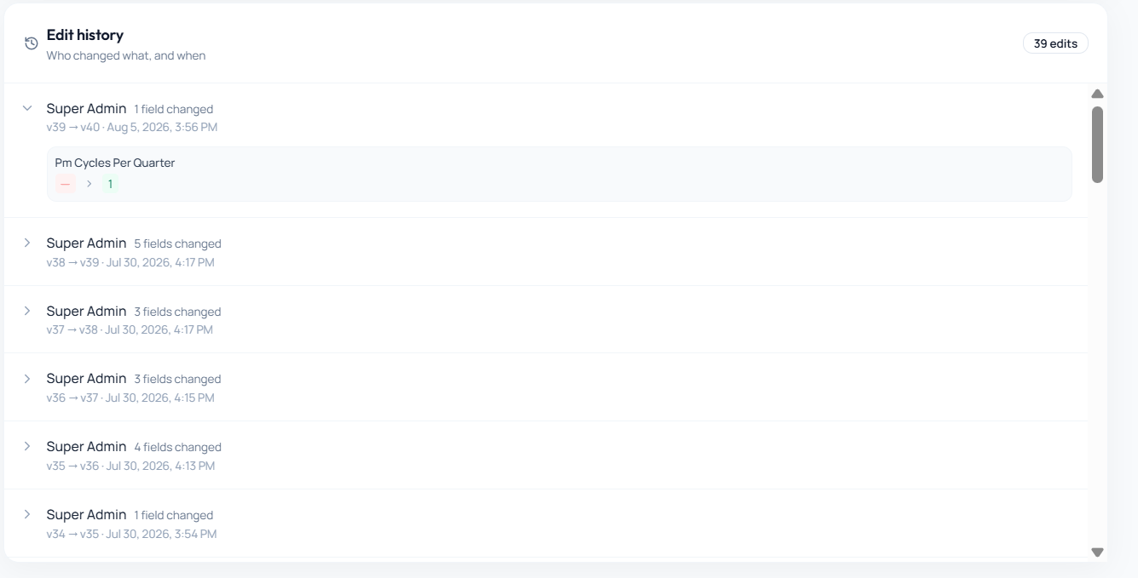
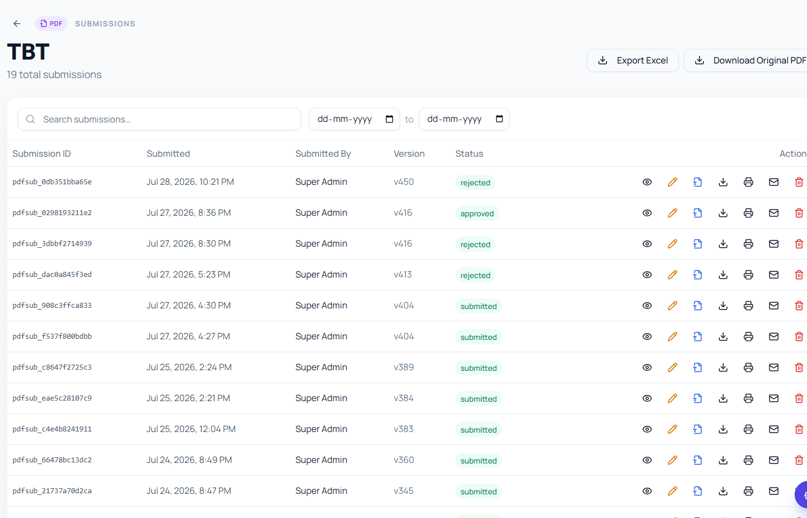
STEP 4 OF 5 · EVERY ACTION, RECORDED
A Complete, Provable History
Every submission is logged with who submitted it, from where, and exactly when.
Every edit to a site or master record is snapshotted — field by field — before and after.
Nothing is overwritten silently; the full change history is always available to review.
Records export to Excel in one click for any internal or external audit.
Field-level edit history — exactly what changed, and who changed it
FormForge · Document & Operations Platform
9

Slide 10
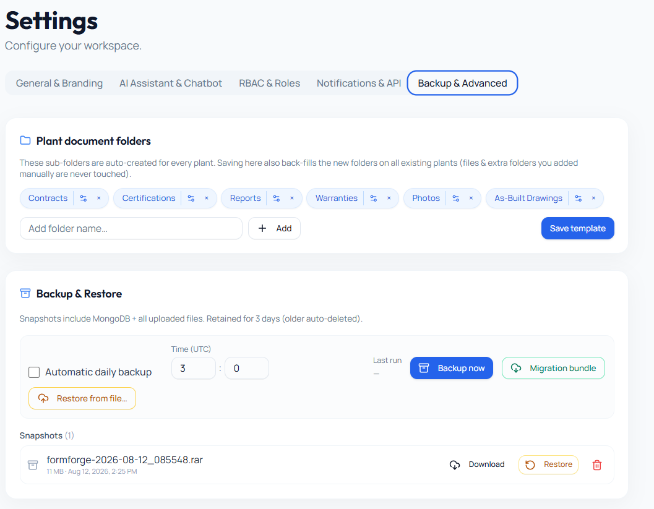



STEP 5 OF 5 · DOCUMENT MANAGEMENT
The Long-Term Vault
This is the piece that protects everything else on the previous slides.
Backed up automatically, every day
Password-Protected .RAR Format: Built-in WinRAR AES-256 header and data encryption (-hp<password>).
Restored with a single file
Password-Verified Restore: Manual snapshots use custom passwords; daily runs use system .env key. Restoration requires valid key.
Portable across servers
A full “migration bundle” lets us move the whole system to new infrastructure without losing a single record.
Kept for as long as we need it
Retention isn't an afterthought — it's built into how every record is stored from day one.
Native .RAR Encrypted Backups, Password-Verified Restore & Migration
FormForge · Document & Operations Platform
10
10

Slide 11





PUTTING IT TOGETHER
Document Management Sits at the Centre
Everything on the last five slides is really one continuous loop, not five separate tools.
Capture
DOCUMENT
MANAGEMENT
Audit
Route
retain · secure · restore
FormForge · Document & Operations Platform
11
Comply
Approve

Slide 12
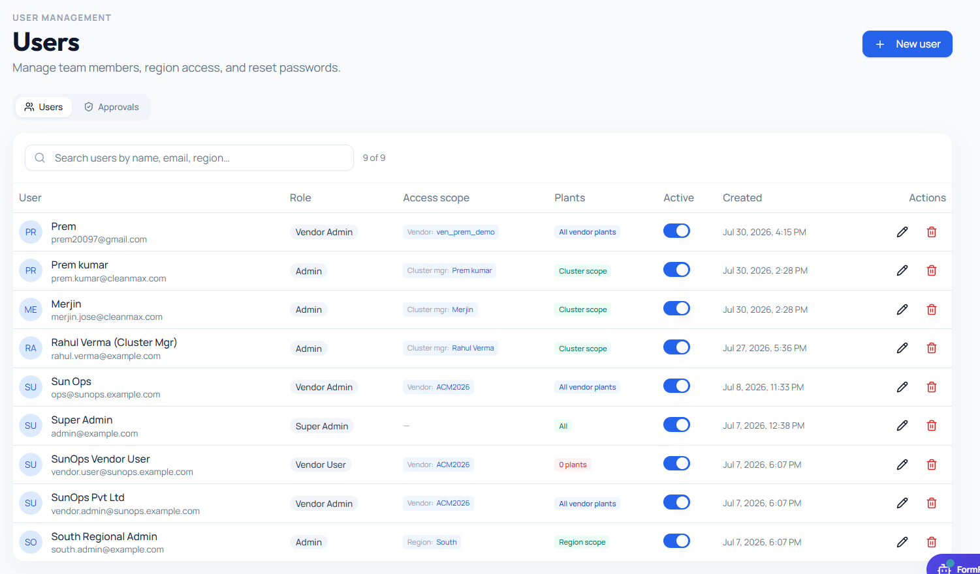
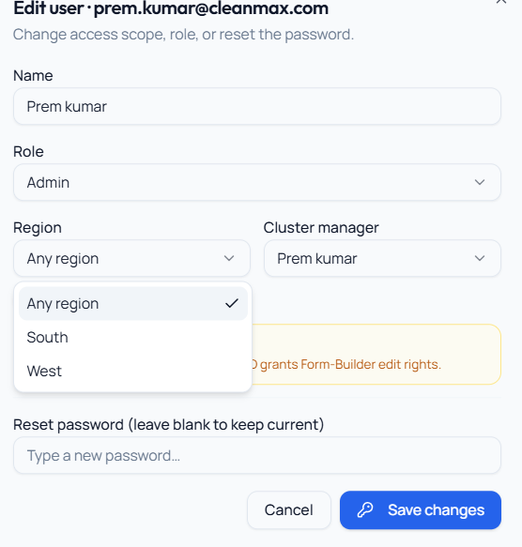
SECURITY & ACCESS
The Right People See the Right Things
Regional leaders automatically see only their own region's data — never another region's.
Vendors see only their own submissions and workers — never a competing vendor's.
Access is assigned by role, not by trust — the system enforces the boundary every time.
Every user, every permission change, is itself logged and reviewable.
One list, every user's exact scope of access
Assigning a regional leader takes one click — the system handles the rest
FormForge · Document & Operations Platform
12

Slide 13



BUILT FOR TRUST
Secure by Design, Not by Accident
Online Production Switcher & Single Scrollbar: 1-click domain link configuration (CORS, HTTPS, HSTS) with locked 100vh viewport to eliminate double scrollbars.
Vendor Workflow Isolation: Vendor roles are strictly restricted from seeing or accessing internal Workflow Automations & Analytics.
1-Click Production Deployment: Entering domain link (e.g. https://forms.cleanmax.com) automatically locks CORS origins, enables HTTPS HSTS, and generates Nginx/SSL scripts.
Single Scrollbar & Page Height Limit: Root window 100vh lock prevents double scrollbars; includes dedicated Sidebar Menu Overlay.
Vendor Workflow Isolation: Workflow Automation and Analytics are strictly hidden from Vendor tier users.
Self-hosted
Encrypted
Controlled access
Runs on our own infrastructure — company data never has to leave our network.
All traffic is encrypted in transit; passwords are never stored as plain text.
Every screen and record is gated by role, region and vendor — enforced automatically.
Always backed up
Fully auditable
Fails safe
Daily, automatic, and restorable in minutes — covered in detail on the vault slide.
Every login, edit and approval is logged — nothing happens off the record.
If any optional add-on (like the AI assistant) goes down, core operations are unaffected.
FormForge · Document & Operations Platform
13
13

Slide 14
WHY IT MATTERS
The Business Impact
24h → <1h
100%
≤2 min
Target permit turnaround time, start to approved
Of field submissions digital — zero paper in the process
Time to get a filled, signed PDF back after submitting
0
≤2%
Daily
Tolerance for one region or vendor seeing another's data
Target rate of approvals breaching their SLA
Automatic backups of every form, submission and file
FormForge · Document & Operations Platform
14

Slide 15
WHERE WE'RE HEADED
The Roadmap
Near-term
Mid-term
Long-term
Next quarter
6–12 months
12 months+
Self-service dashboard for each vendor
Automated reminders before deadlines are missed
Deeper, exportable compliance reporting
Vendor performance scorecards
Region-level compliance heatmaps
Weekly summary emails for leadership
Single sign-on across company systems
Scale to every site, vendor and region
On-site AI assistant for field troubleshooting — grounded only in our own manuals, always human-approved
FormForge · Document & Operations Platform
15

Slide 16



WHAT WE NEED FROM LEADERSHIP
The Ask
Executive sponsorship
One pilot site, one champion
A visible mandate so every region and vendor adopts the platform, not just early volunteers.
A single site to run the full rollout playbook end-to-end before we scale it everywhere.
A phased rollout timeline
A quarterly review
Agreement on a realistic sequence — capture and approvals first, full reporting and roadmap items after.
A standing check-in so this stays a living platform, not a one-time project.
FormForge · Document & Operations Platform
16

Slide 17
Thank You
One platform. Every document. Always accounted for.
Questions & discussion welcome

